Slide 1

Hotel Booking System

Slide 2
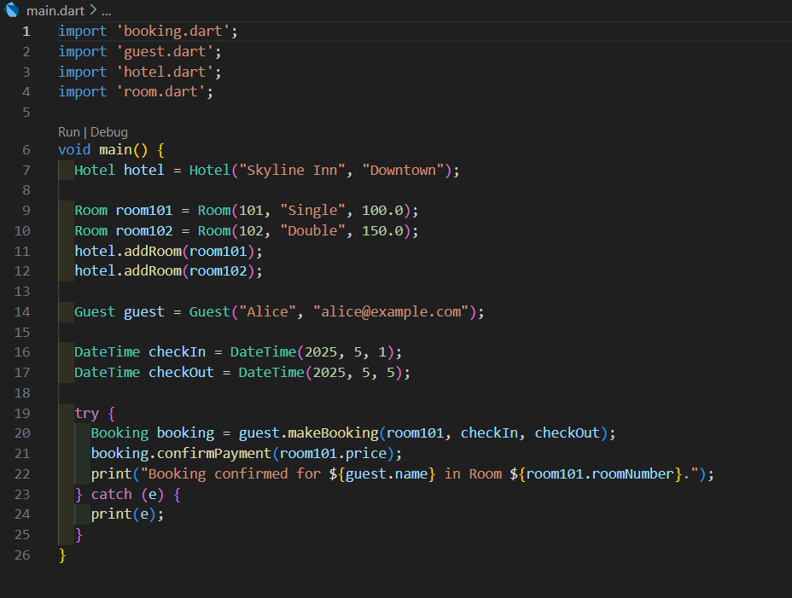
A Dart program simulating a hotel booking system. Key Features: Add hotels and rooms. Guests can book rooms. Check room availability. Process payments.

Slide 3
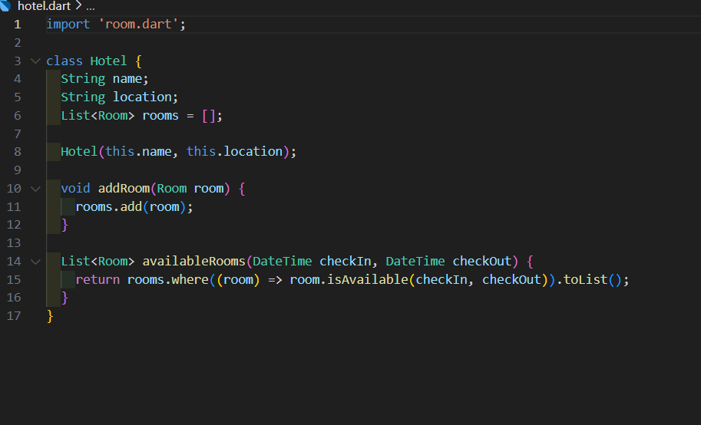
1. Hotel Class
Fields: name, location, List<Room> rooms
Methods:
addRoom(): Adds a room to the hotel.
availableRooms(): Returns rooms free for given dates.

Slide 4
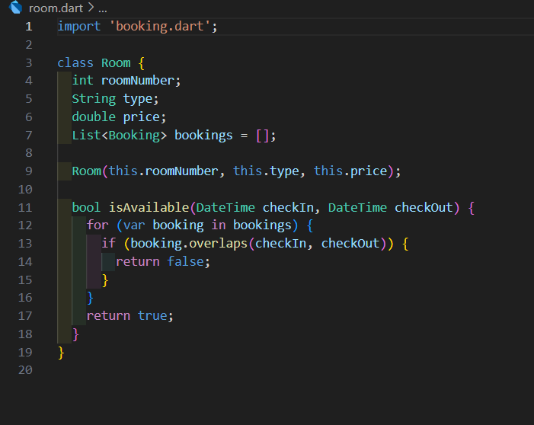
Room Class
Fields: roomNumber, type, price, List<Booking> bookings
Methods:
isAvailable(): Checks if the room is free for a date range.

Slide 5
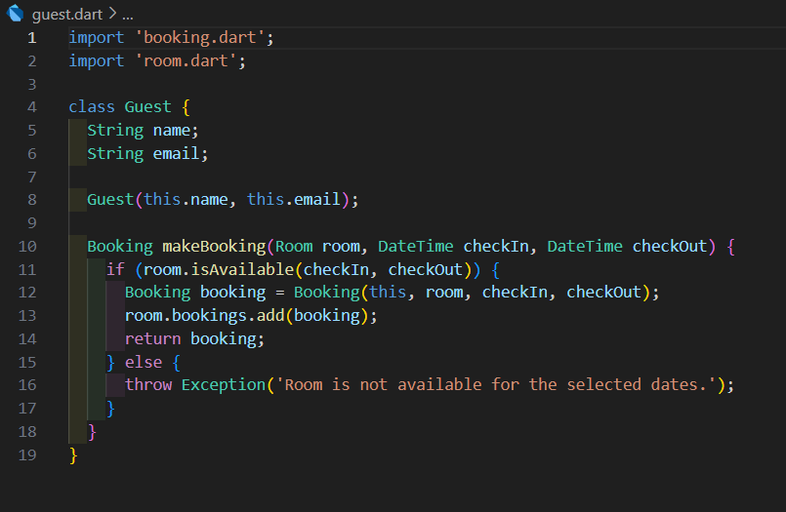
3. Guest Class
Fields: name, email
Methods:
makeBooking(): Books a room if available.

Slide 6
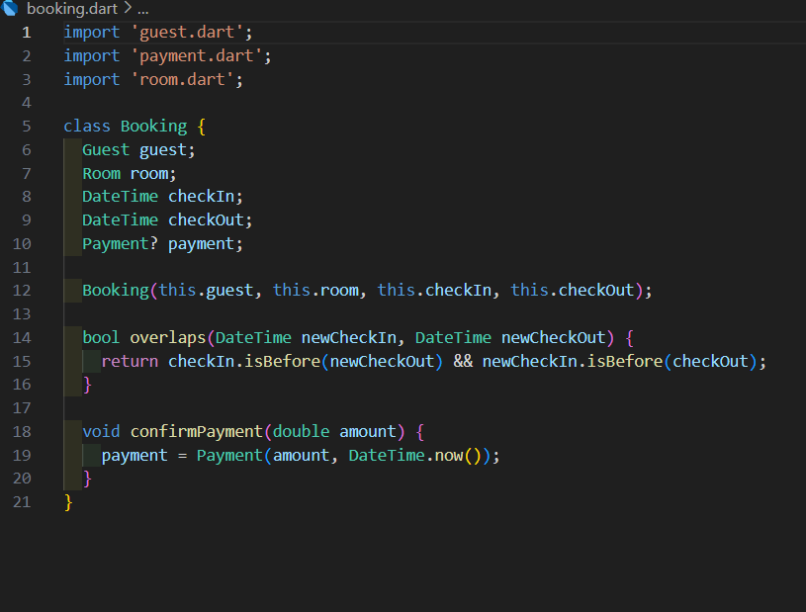
Booking Class
Fields: guest, room, checkIn, checkOut, Payment? payment
Methods:
overlaps(): Checks date conflicts.
confirmPayment(): Records payment.

Slide 7
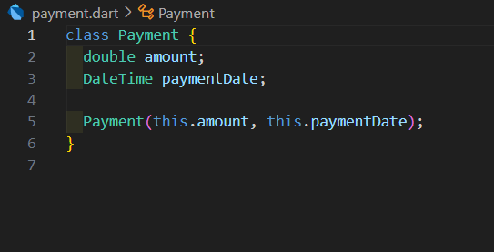
5. Payment Class
Fields: amount, paymentDate

Slide 8
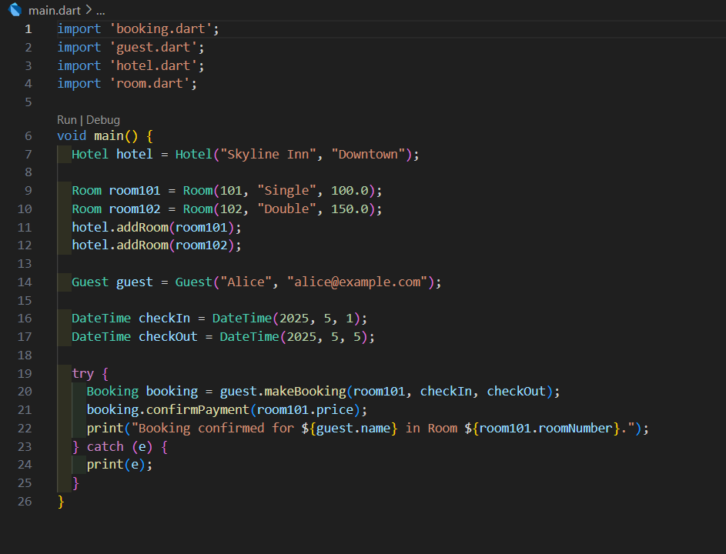
How a Booking Works:
Guest checks room availability (room.isAvailable()).
Guest books a room (guest.makeBooking()).
Payment is confirmed (booking.confirmPayment()).

Slide 9

Key Relationships:
Hotel to Room: One-to-many (1..*)
A Hotel contains multiple Rooms
Shown with solid line and filled diamond (composition)
Room to Booking: One-to-many (1..*)
A Room can have multiple Bookings
Shown with solid line and filled diamond (composition)
Guest to Booking: One-to-many (1..*)
A Guest can make multiple Bookings
Shown with solid line and arrow (association)
Booking to Payment: One-to-one (0..1)
A Booking may have one Payment (optional)
Shown with dashed line and arrow (dependency)

Slide 10
